Slide 1
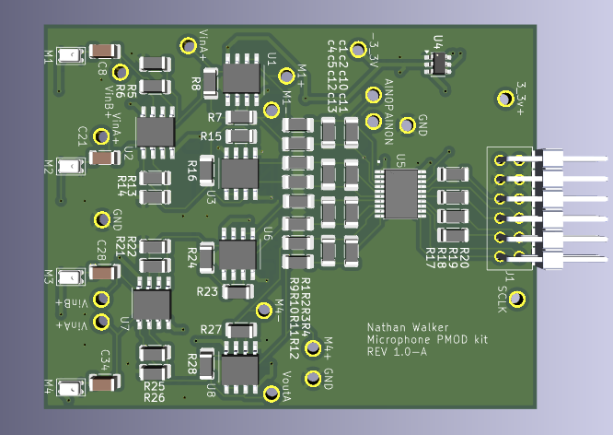

Audio DSP Pmod Kit
This project is a Pmod kit. The Xilinx Basys 3 board is an FPGA that all undergrad students purchase. Pmod kits allow to extend the FPGA’s usuability by adding additional hardware to interface with. This kit aims to adding audio sensing to the Basys 3 board so that students can write algorithms for audio signal processing. This project also relies on other Pmod kits that has a speaker output.
Nathan Walker – Electrical Engineering Master's Student – May 2026
ECE 6930

